Slide 1
UNIT 4 DESIGN ENGINEERING

Slide 2
Software design encompasses the set of principles, concepts, and practices that lead to the development of a high-quality system or product.
Design concepts must be understood before the mechanics of design practice are applied, and design practice itself leads to the creation of various representations of the software that serve as a guide for the construction activity that follows.

Slide 3
“diversification is the acquisition of a repertoire of alternatives
The raw material of design: components, component solutions, and knowledge, all contained in catalogs, textbooks, and the mind.”
Once this diverse set of information is assembled, you must pick and choose elements from the repertoire that meet the requirements defined by requirements engineering and the analysis model.

Slide 4
DESIGN WITHIN THE CONTEXT OF SOFTWARE ENGINEERING
Software design sits at the technical kernel of software engineering and is applied regardless of the software process model that is used.
Beginning once software requirements have been analyzed and modeled, software design is the last software engineering action within the modeling activity and sets the stage for construction (code generation and testing).
Using design notation and design methods, design produces a data/class design, an architectural design, an interface design, and a component design.

Slide 5
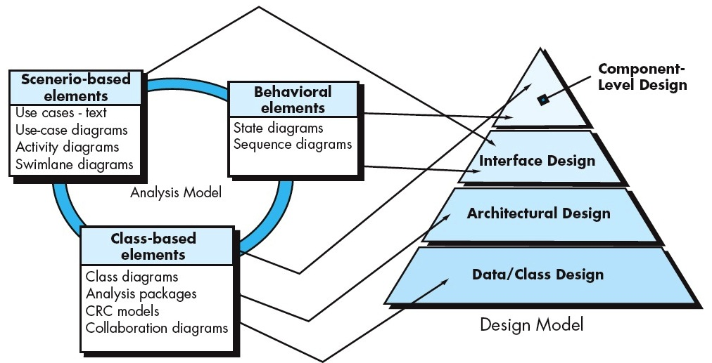

Slide 6
The data/class design transforms class models into design class realizations and the requisite data structures required to implement the software.
The architectural design defines the relationship between major structural elements of the software, the architectural styles and patterns that can be used to achieve the requirements defined for the system, and the constraints that affect the way in which architecture can be implemented.
The interface design describes how the software communicates with systems that interoperate with it, and with humans who use it. An interface implies a flow of information (e.g., data and/or control) and a specific type of behavior.

Slide 7
why is design so important? The importance of software design can be stated with a single word— quality .
Design is the place where quality is fostered in software engineering. Design provides you with representations of software that can be assessed for quality.
Design is the only way that you can accurately translate stakeholder’s requirements into a finished software product or system. Software design serves as the foundation for all the software engineering and software support activities that follow. Without design, you risk building an unstable system—one that will fail when small changes are made; one that may be difficult to test; one whose quality cannot be assessed until late in the software process, when time is short and many dollars have already been spent.

Slide 8
4.2 THE DESIGN PROCESS
Software design is an iterative process through which requirements are translated into a “blueprint” for constructing the software. Initially, the blueprint depicts a holistic view of software.
That is, the design is represented at a high level of abstraction—a level that can be directly traced to the specific system objective and more detailed data, functional, and behavioral requirements.
As design iterations occur, subsequent refinement leads to design representations at much lower levels of abstraction. These can still be traced to requirements, but the connection is more subtle.

Slide 9
4.2.1 Software Quality Guidelines and Attributes
Throughout the design process, the quality of the evolving design suggests three characteristics that serve as a guide for the evaluation of a good design :
• The design should implement all of the explicit requirements contained in the requirements model, and it must accommodate all of the implicit requirements desired by stakeholders.
• The design should be a readable, understandable guide for those who generate code and for those who test and subsequently support the software.
• The design should provide a complete picture of the software, addressing the data, functional, and behavioral domains from an implementation perspective.
Each of these characteristics is actually a goal of the design process. But how is each of these goals achieved?

Slide 10
1. A design should exhibit an architecture that
(1) has been created using recognizable architectural styles or patterns,
(2) is composed of components that exhibit good design characteristics
(3) can be implemented in an evolutionary fashion, thereby facilitating implementation and testing.
2. A design should be modular; that is, the software should be logically partitioned into elements or subsystems.
3. A design should contain distinct representations of data, architecture, interfaces, and components.
4. A design should lead to data structures that are appropriate for the classes to be implemented and are drawn from recognizable data patterns.

Slide 11
5. A design should lead to components that exhibit independent functional characteristics.
6. A design should lead to interfaces that reduce the complexity of connections between components and with the external environment.
7. A design should be derived using a repeatable method that is driven by information obtained during software requirements analysis.
8. A design should be represented using a notation that effectively communicates its meaning.
These design guidelines are not achieved by chance. They are achieved through the application of fundamental design principles, systematic methodology and thorough review.

Slide 12
Quality Attributes : Software quality attributes represents a target for all software design:
• Functionality is assessed by evaluating the feature set and capabilities of the program, the generality of the functions that are delivered, and the security of the overall system.
• Usability is assessed by considering human factors, overall aesthetics, consistency, and documentation.
• Reliability is evaluated by measuring the frequency and severity of failure, the accuracy of output results, the mean-time-to-failure (MTTF), the ability to recover from failure, and the predictability of the program.
• Performance is measured using processing speed, response time, resource consumption, throughput, and efficiency.

Slide 13
• Supportability combines extensibility, adaptability, and serviceability.
These three attributes represent a more common term, maintainability — and in addition, testability, compatibility, configurability (the ability to organize and control elements of the software configuration), the ease with which a system can be installed, and the ease with which problems can be localized.

Slide 14
4.3 DESIGN CONCEPTS
A set of fundamental software design concepts are:
4.3.1 Abstraction
When you consider a modular solution to any problem, many levels of abstraction can be posed.
A procedural abstraction refers to a sequence of instructions that have a specific and limited function. The name of a procedural abstraction implies these functions, but specific details are suppressed.
A data abstraction is a named collection of data that describes a data object. In the context of the procedural abstraction open, we can define a data abstraction called door.

Slide 15
4.3.2 Architecture
Software architecture alludes to “the overall structure of the software and the ways in which that structure provides conceptual integrity for a system”.
In its simplest form, architecture is the structure or organization of program components (modules), the manner in which these components interact, and the structure of data that are used by the components.
One goal of software design is to derive an architectural rendering of a system. This rendering serves as a framework from which more detailed design activities are conducted.

Slide 16
A set of properties that should be specified as part of an architectural design.
Structural properties - defines the components of a system (e.g., modules, objects, filters) and the manner in which those components are packaged and interact with one another.
Extra-functional properties address - how the design architecture achieves requirements for performance, capacity, reliability, security, adaptability, and other system characteristics.
Families of related systems- draw upon repeatable patterns that are commonly encountered in the design of families of similar systems.

Slide 17
The architectural design can be represented using a number of different models.
Structural models - represent architecture as an organized collection of program components.
Framework models - increase the level of design abstraction by attempting to identify repeatable architectural design frameworks (patterns) that are encountered in similar types of applications.
Dynamic models - address the behavioral aspects of the program architecture, indicating how the structure or system configuration may change as a function of external events.
Process models - Focus on the design of the business or technical process that the system must accommodate.
Functional models - Can be used to represent the functional hierarchy of a system.
A number of different architectural description languages (ADLs) have been developed to represent models.

Slide 18
4.3.3 Patterns
Design pattern can be defined as : A design pattern describes a design structure that solves a particular design problem within a specific context and amid “forces” that may have an impact on the manner in which the pattern is applied and used.
The intent of each design pattern is to provide a description that enables a designer to determine
(1) Whether the pattern is applicable to the current work,
(2) Whether the pattern can be reused (hence, saving design time), and
(3) Whether the pattern can serve as a guide for developing a similar, but functionally or structurally different pattern.

Slide 19
4.3.4 Separation of Concerns
Separation of concerns is a design concept that suggests that any complex problem can be more easily handled if it is subdivided into pieces that can each be solved and/or optimized independently.
A concern is a feature or behavior that is specified as part of the requirements model for the software.
By separating concerns into smaller, and therefore more manageable pieces, a problem takes less effort and time to solve.
This leads to a divide-and-conquer strategy.

Slide 20
12.3.5 Modularity
Modularity is the most common manifestation of separation of concerns. Software is divided into separately named and addressable components, sometimes called modules, that are integrated to satisfy problem requirements.
Modularity is the single attribute of software that allows a program to be intellectually manageable.
Monolithic software (i.e., a large program composed of a single module) cannot be easily grasped by a software engineer.
The number of control paths, span of reference, number of variables, and overall complexity would make understanding close to impossible.

Slide 21
you should break the design into many modules, hoping to make understanding easier and, as a consequence, reduce the cost required to build the software.
To conclude that if you subdivide software indefinitely the effort required to develop it will become negligibly small!
Referring to Figure, the effort (cost) to develop an individual software module does decrease as the total number of modules increases.
Given the same set of requirements, more modules means smaller individual size. However, as the number of modules grows, the effort (cost) associated with integrating the modules also grows.

Slide 22
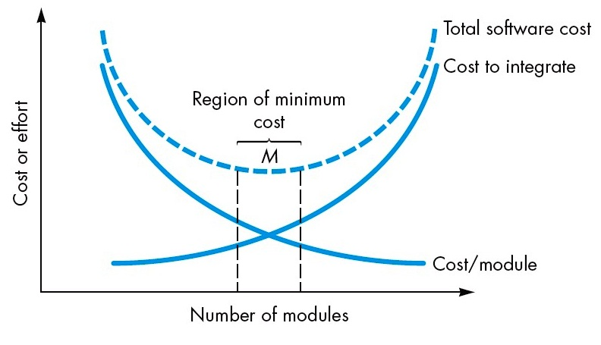
The curves shown in Figure, do provide useful qualitative guidance when modularity is considered. You should modularize, but care should be taken to stay in the vicinity of M. Under modularity or over modularity should be avoided.

Slide 23
4.3.6 Information Hiding
The concept of modularity leads you to a fundamental question: “How do I decompose a software solution to obtain the best set of modules?”
The principle of information hiding suggests that modules be “characterized by design decisions that (each) hides from all others.”
In other words, modules should be specified and designed so that information (algorithms and data) contained within a module is inaccessible to other modules that have no need for such information.
Hiding implies that effective modularity can be achieved by defining a set of independent modules that communicate with one another only that information necessary to achieve software function.

Slide 24
4.3.7 Functional Independence
The concept of functional independence is a direct outgrowth of separation of concerns, modularity, and the concepts of abstraction and information hiding.
Functional independence is achieved by developing modules with “single minded” function and an “a version” to excessive interaction with other modules.
Stated another way, you should design software so that each module addresses a specific subset of requirements and has a simple interface when viewed from other parts of the program structure.
Functional independence is a key to good design, and design is the key to software quality.

Slide 25
Independence is assessed using two qualitative criteria: cohesion and coupling.
Cohesion is an indication of the relative functional strength of a module.
Coupling is an indication of the relative interdependence among modules.
A cohesive module performs a single task, requiring little interaction with other components in other parts of a program. Stated simply, a cohesive module should (ideally) do just one thing.
Coupling is an indication of interconnection among modules in a software structure. Coupling depends on the interface complexity between modules, the point at which entry or reference is made to a module, and what data pass across the interface.

Slide 26
4.3.8 Refinement
Stepwise refinement is a top-down design strategy.
An application is developed by successively refining levels of procedural detail.
A hierarchy is developed by decomposing a macroscopic statement of function (a procedural abstraction) in a stepwise fashion until programming language statements are reached.
Refinement is actually a process of elaboration. You begin with a statement of function (or description of information) that is defined at a high level of abstraction.

Slide 27
Abstraction and refinement are complementary concepts. Abstraction enables you to specify procedure and data internally but suppress the need for “outsiders” to have knowledge of low-level details.
Refinement helps you to reveal low-level details as design progresses.
Both concepts allow you to create a complete design model as the design evolves.

Slide 28
4.3.9 Refactoring
An important design activity suggested for many agile methods, refactoring is a reorganization technique that simplifies the design (or code) of a component without changing its function or behavior.
Fowler defines refactoring in the following manner: “Refactoring is the process of changing a software system in such a way that it does not alter the external behavior of the code [design] yet improves its internal structure.”
When software is refactored, the existing design is examined for redundancy, unused design elements, inefficient or unnecessary algorithms, poorly constructed or inappropriate data structures, or any other design failure that can be corrected to yield a better design.

Slide 29
4.3.10 Design Classes
As the design model evolves, you will define a set of design classes that refine the analysis classes by providing design detail that will enable the classes to be implemented, and implement a software infrastructure that supports the business solution.
Five different types of design classes, each representing a different layer of the design architecture, can be developed.
1) User interface classes define all abstractions that are necessary for Human-Computer Interaction (HCI) and often implement the HCI.

Slide 30
2) Business domain classes identify the attributes and services (methods) that are required to implement some element of the business domain that was defined by one or more analysis classes.
3) Process classes implement lower-level business abstractions required to fully manage the business domain classes.
4) Persistent classes represent data stores (e.g., a database) that will persist beyond the execution of the software.
5) System classes implement software management and control functions that enable the system to operate and communicate within its computing environment and with the outside world.

Slide 31
That is, analysis classes represent data objects (and associated services that are applied to them).
Characteristics of a well-formed design class:
Complete and sufficient : A design class should be the complete encapsulation of all attributes and methods that can reasonably be expected (based on a knowledgeable interpretation of the class name) to exist for the class.
For example, the class Scene defined for video-editing software is complete only if it contains all attributes and methods that can reasonably be associated with the creation of a video scene.
Sufficiency ensures that the design class contains only those methods that are sufficient to achieve the intent of the class, no more and no less.

Slide 32
2) Primitiveness : Methods associated with a design class should be focused on accomplishing one service for the class. Once the service has been implemented with a method, the class should not provide another way to accomplish the same thing.
For example, the class Video Clip for video editing software might have attributes and to indicate the start and end points of the clip (note that the raw video loaded into the system may be longer than the clip that is used). The methods, setStart- Point() and setEndPoint(), provide the only means for establishing start and end points for the clip.

Slide 33
3) High cohesion. A cohesive design class has a small, focused set of responsibilities and single-mindedly applies attributes and methods to implement those responsibilities.
For example, the class VideoClip might contain a set of methods for editing the video clip. As long as each method focuses solely on attributes associated with the video clip, cohesion is maintained.
4) Low coupling. Within the design model, it is necessary for design classes to collaborate with one another. However, collaboration should be kept to an acceptable minimum. If a design model is highly coupled (all design classes collaborate with all other design classes), the system is difficult to implement, to test, and to maintain over time.
In general, design classes within a subsystem should have only limited knowledge of other classes.

Slide 34
4.4 THE DESIGN MODEL
The design model can be viewed in two different dimensions as illustrated in Figure.
The process dimension indicates the evolution of the design model as design tasks are executed as part of the software process.
The abstraction dimension represents the level of detail as each element of the analysis model is transformed into a design equivalent and then refined iteratively.
Referring to the figure, the dashed line indicates the boundary between the analysis and design models.
In some cases, a clear distinction between the analysis and design models is possible.
In other cases, the analysis model slowly blends into the design and a clear distinction is less obvious.

Slide 35
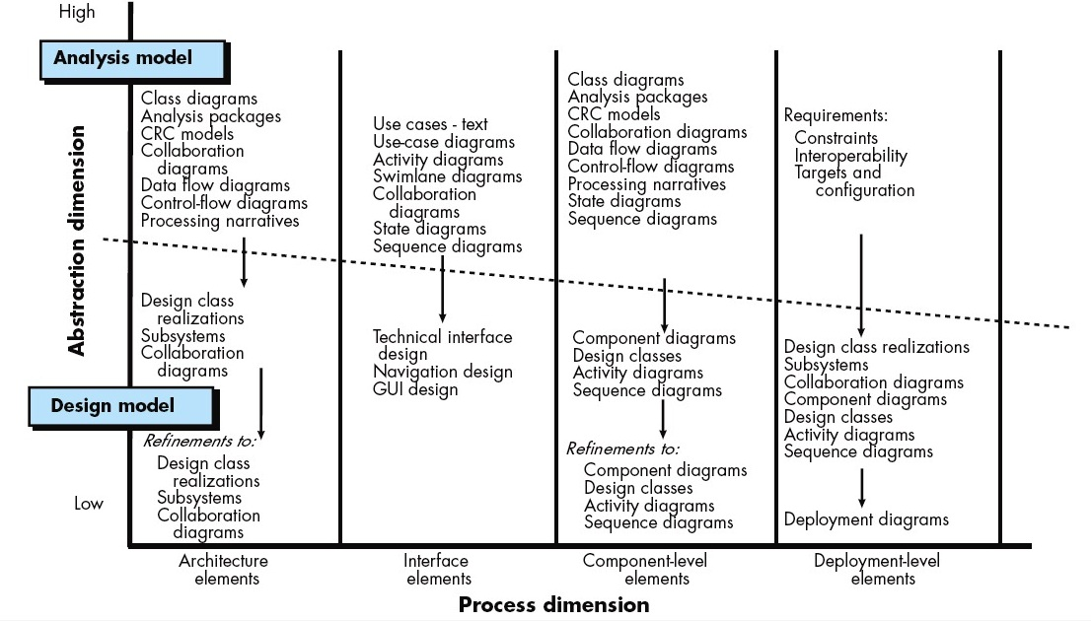

Slide 36
The elements of the design model use many of the same UML diagrams that were used in the analysis model.
The difference is that these diagrams are refined and elaborated as part of design;
more implementation-specific detail is provided, and architectural structure and style, components that reside within the architecture, and interfaces between the components and with the outside world are all emphasized.

Slide 37
The model elements indicated along the horizontal axis are not always developed in a sequential fashion.
In most cases preliminary architectural design sets the stage and is followed by interface design and component-level design, which often occur in parallel. The deployment model is usually delayed until the design has been fully developed.
You can apply design patterns at any point during design. These patterns enable you to apply design knowledge to domain-specific problems that have been encountered and solved by others.

Slide 38
4.4.1 Data Design Elements
Like other software engineering activities, data design (data architecting ) creates a model of data and/or information that is represented at a high level of abstraction (the customer/user’s view of data).
This data model is then refined into progressively more implementation-specific representations that can be processed by the computer-based system.
In many software applications, the architecture of the data will have a profound influence on the architecture of the software that must process it.

Slide 39
The structure of data is an important part of software design. At the program-component level, the design of data structures and the associated algorithms required to manipulate them is essential to the creation of high- quality applications. At the application level, the translation of a data model (derived as part of requirements engineering) into a database is pivotal to achieving the business objectives of a system.
At the business level, the collection of information stored in disparate databases and reorganized into a “data warehouse” enables data mining or knowledge discovery.

Slide 40
4.4.2 Architectural Design Elements
The architectural design for software is the equivalent to the floor plan of a house. The floor plan depicts the overall layout of the rooms; their size, shape, and relationship to one another; and the doors and windows that allow movement into and out of the rooms. The floor plan gives us an overall view of the house. Architectural design elements give us an overall view of the software.
The architectural model is derived from three sources:
Information about the application domain for the software to be built;
Specific requirements model elements such as use cases or analysis classes, their relationships and collaborations for the problem at hand;
The availability of architectural styles and patterns.

Slide 41
The architectural design element is usually depicted as a set of interconnected subsystems, often derived from analysis packages within the requirements model.
Each subsystem may have its own architecture (e.g., a graphical user interface might be structured according to a preexisting architectural style for user interfaces).

Slide 42
4.4.3 Interface Design Elements
The interface design for software is similar to a set of detailed drawings (and specifications) tell us how things and information flow into and out.
The interface design elements for software depict information flows into and out of a system and how it is communicated among the components defined as part of the architecture.
There are three important elements of interface design:
The user interface (UI),
External interfaces to other systems, devices,networks, or other producers or consumers of information.
Internal interfaces between various design components. These interface design elements allow the software to communicate externally and enable internal communication and collaboration among the components that populate the software architecture.

Slide 43
UI design (increasingly called usability design ) is a major software engineering action. Usability design incorporates aesthetic elements (e.g., layout, color, graphics, interaction mechanisms), ergonomic elements (e.g., information layout and placement, metaphors, UI navigation), and Technical elements (e.g., UI patterns, reusable components).
The UI is a unique subsystem within the overall application architecture.
The design of external interfaces requires definitive information about the entity to which information is sent or received.
The design of external interfaces should incorporate error checking and appropriate security features.
The design of internal interfaces is closely aligned with component-level design .

Slide 44
Design realizations of analysis classes represent all operations and the messaging schemes required to enable communication and collaboration between operations in various classes.
Each message must be designed to accommodate the requisite information transfer and the specific functional requirements of the operation that has been requested.
In some cases, an interface is modeled in much the same way as a class. In UML, an interface is defined in the following manner : “An interface is a specifier for the externally-visible [public] operations of a class, component, or other classifier (including subsystems) without specification of internal structure.”

Slide 45
For example, the SafeHome security function makes use of a control panel that allows a home owner to control certain aspects of the security function.
In an advanced version of the system, control panel functions may be implemented via a mobile platform (e.g., smart phone or tablet).
The ControlPanel class (Figure) provides the behavior associated with a keypad, and therefore, it must implement the operations readKeyStroke() and decodeKey () .
If these operations are to be provided to other classes (in this case, Tablet and SmartPhone ), it is useful to define an interface as shown in the figure.

Slide 46
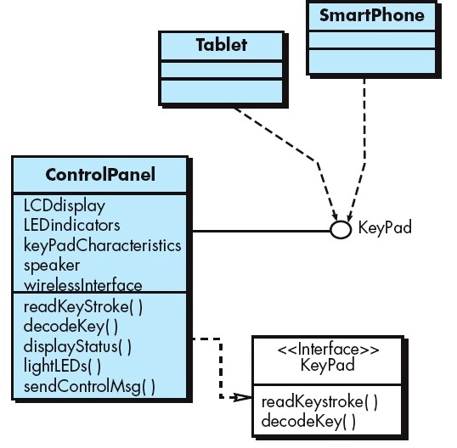
The interface, named KeyPad , is shown as an <<interface>> stereotype or as a small, labeled circle connected to the class with a line. The interface is defined with no attributes and the set of operations that are necessary to achieve the behavior of a keypad.

Slide 47
The dashed line with an open triangle at its end (Figure) indicates that the ControlPanel class provides KeyPad operations as part of its behavior.
In UML, this is characterized as a realization. That is, part of the behavior of ControlPanel will be implemented by realizing KeyPad operations. These operations will be provided to other classes that access the interface.

Slide 48
4.4.4 Component-Level Design Elements
The component-level design for software is the equivalent to a set of detailed drawings (and specifications) for each room in a house. These drawings depict wiring and plumbing within each room, the location of electrical receptacles and wall switches, faucets, sinks, showers, tubs, drains, cabinets, and closets, and every other detail associated with a room.
The component-level design for software fully describes the internal detail of each software component.
To accomplish this, the component-level design defines data structures for all local data objects and algorithmic detail for all processing that occurs within a component and an interface that allows access to all component operations (behaviors).

Slide 49
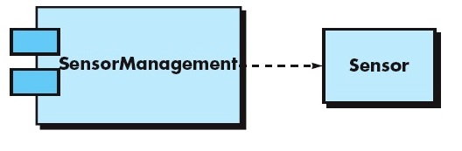
Within the context of object-oriented software engineering, a component is represented in UML diagrammatic form as shown in Figure.
In this figure, a component named Sensor Management (part of the SafeHome security function) is represented.
A dashed arrow connects the component to a class named Sensor that is assigned to it.
The Sensor Management component performs all functions associated with SafeHome sensors including monitoring and configuring them.

Slide 50
The design details of a component can be modeled at many different levels of abstraction. A UML activity diagram can be used to represent processing logic. Detailed procedural flow for a component can be represented using either pseudocode (a programming language like representation) or some other diagrammatic form (e.g., flowchart or box diagram).
Algorithmic structure follows the rules established for structured programming (i.e., a set of constrained procedural constructs). Data structures, selected based on the nature of the data objects to be processed, are usually modeled using pseudocode or the programming language to be used for implementation.

Slide 51
12.4.5 Deployment-Level Design Elements
Deployment-level design elements indicate how software functionality and subsystems will be allocated within the physical computing environment that will support the software.
For example, the elements of the SafeHome product are configured to operate within three primary computing environments—a home based PC, the SafeHome control panel, and a server (providing Internet-based access to the system). In addition, limited functionality may be provided with mobile platforms.
During design, a UML deployment diagram is developed and then refined as shown in Figure. In the figure, three computing environments are shown (in actuality, there would be more including sensors, cameras, and functionality delivered by mobile platforms).

Slide 52
The subsystems (functionality) housed within each computing element are indicated. For example, the personal computer houses subsystems that implement security, surveillance, home management, and communications features. In addition, an external access subsystem has been designed to manage all attempts to access the SafeHome system from an external source.
Each subsystem would be elaborated to indicate the components that it implements.
The diagram shown in Figure is in descriptor form. This means that the deployment diagram shows the computing environment but does not explicitly indicate configuration details.

Slide 53
